Slide 1
COMPANY PROFILE

Slide 2
Subhash Chandra Jha
Mo. : 9825378368
INSULATION ENGINEERS & CONTRACTORS
Specialist of All Types Hot & Cold Insulation
K – 104 Ozone Glitter, Naroda Galaxy to ITI Road Nobel Nagar Ahmedabad - 382340
E-mail : sj.insulation@gmail.com
nfo@sjinsulation.com
Web : www.sjinsulation.com

Slide 3
CONTENTS
Sr. No. | DESCRIPTION | PAGE NO.
1 | Contents | 1
2 | History | 2
3 | Corporate Profile | 3
4 | Quality Objective | 6
5 | Registration Details | 8
6 | List of Clients | 9
7 | List of Projects Ongoing / Completed | 10
8 | Reference WO of few projects | 17
9 | Details of Tool & Tackles | 29
10 | Man Power Mobilization | 30
11 | Photographs of Complete Projects | 31

Slide 4
HISTORY
Long Term Definite Potential in all kinds of HVAC Duct Line Fabrication, Duct Acoustic, Room Acoustic, Thermal &Insulation a team of Engineers and Professionals from Different field with a Common Goal has decided to establish a Company to take the utmost advantage of present booming economy of India.
Presently Company is On the Way of Fasten their belt to take the stiff challenges. Company will try to look forward for big challenging projects where they can show wide skill and capabilities and assures value addition to the organization in forthcoming days.

Slide 5
Company Profile
S.J. Insulation was founded in Ahmedabad in 2011.s.j.insulation has been committed to providing our customers with excellent services in hot insulation, cold insulation, Thermal Insulation, Under Deck Insulation, Wall & Duct acoustic insulation work in various field of application like power plant, oil and gas refinery, fertilizer plant. s.j. insulation was worked with Larsen and toubro limited, ipr extension, Hindustan coca cola pvt. ltd, reliance industries ltd, excel crop care, etc. s.j.insulation is worked multinational company. turnover of this company is 650 Lakh to 700 Lakh yearly.

Slide 6
Considering our quality of work & speedy execution of jobs we have been appointed on permanent basis on rate contract for routine Maintenance & Project jobs with many good companies.
Over the years we have executed the mechanical and insulation works for a number of companies to their satisfaction & within the specified time schedule.
Some of the prestigious projects that we have successfully executed executing are as under.

Slide 7
We People
we at S.J. Insulation apeople -driven enterprise with well qualified and experienced Execution Team generate multi-disciplinary skilled and a wide range of experience in projects execution for diverse projects spread anywhere.
With the attitude of not compromising on quality and giving almost importance to the customers. within a short period, S. J. Insulation has been able to establish itself as a reliable source in engineering works.
Values
Our Values with a code of conduct are essence of our victory. We understand the organizational requirements and positive response with speed and we are committed and intensely focused on keeping the strong reputation, we are here to make a valuable difference to our organization and work as a Team with sharing knowledge and resources to achieve individual and organizational goal.

Slide 8
Our Mission
To build long term relationship with our customer and clients and provide exceptional customer service by pursuing business through innovation and advance technology.
Our Vision
To provide quality Services that exceeds the expectation of our esteemed customers.
SJ Insulation Committed to total Customer Satisfaction by delivering constant quality in each of its products & Service

Slide 9
Quality Objective
To produce and supply quality products & services all the times, Continuously strive to improve. Be competitive cost effectiveness, render timely service to ensure total customer satisfaction.

Slide 10
Name of Organization | S. J. INSULATION
Contact Person | Subhash Chandra Jha
Constitution | Sub Contractors
Registered with | Larsen & Tourbo Limited
Corp. ID No. | S0039921
PAN | AIGPJ3045E
Service Tax Registration No. | AIGPJ3045ESD001
VAT Tax Registration No | 24075204761
Turn Over | 650 to 700 Lakhs
Working Force | Adequate ( Presently Around 80 Skilled, Semi Skilled & Un Skilled Man Power in hand & arrangement for hiring)
Machineries & Equipment's | Sufficient to Carry And Multiple Projects

Slide 11
Registration Details
Work Type | Project Works ( Labour With Materials & EPC )
Register Address | K - 104, Ozone Glitter Naroda Galaxy To ITI Road Nobel Nagar Ahmedabad - 382340
PAN No. | Larsen & Tourbo Limited
ROC reg. / Corp. ID No. | S0039921
PAN | AIGPJ3045E
Service Tax Registration No.
VAT Tax Registration No | 24075204761
GST No. | 24AIGPJ3045EIZ0

Slide 12
Few of our Satisfied And Existing Customer
Larsen & Tuobro Limited
Excel Crop. Care Ltd.
Voltas Limited
Sterling & Wilson Pvt. Ltd.
Zamil Air Condition (India) Pvt. Ltd.
Aditi Air Conditioning Pvt.Ltd.
Mother Dairy
I.P.R. Plasama
ETA Engineering Pvt. Ltd.
Johnson Controls & Hitachi Air Conditioner
Bony Polymers Ltd.

Slide 13
COMPANY CREDENTIALS
Sr No. | Name of Project | Consultant
1 | GIFTCITY GANDHI NAGAR | Larsen & Toubro Limited
2 | M/s Mangalore Refinery Petrochemical Ltd. Mangalore, Karnataka | Asian Thermal
3 | Mathura   Refinery | Asian Thermal
4 | Gujarat   Refinery | Asian Thermal
5 | Edelweiss Metels Ltd Ahmedabad | Edelweiss Metels Ltd
6 | Bony Polymar Viramgam | Bony Polymar
7 | Mathura   Refinery | Asian Thermal
8 | Mother dary Gandhi Nagar | Mother dary
9 | Reliance Surat | Lloyd
10 | Reliance Refinery Jamnagar Gujrat  | Lloyd
11 | Hindustan Coca cola Beverages Pvt Ltd , Kheda | Hindustan Coca cola
12 | Nakoda Textiles, Kim Surat Gujrat  | Nakoda Textiles
13 | Amneal pharmaceuticals Ahmedabad | Amneal pharmaceuticals

Slide 14
HOSPITALS
V. S. Hospital – Ahmedabad, Gujarat
Sterling Hospital-Ahmedabad, Gujarat.
Civil Hospital - Ahmedabad, Gujarat
Kothiya Hospital – Ahmedabad, Gujarat
Shalbhy Hospital - Ahmedabad, Gujarat.
Krishna Hospital - Ahmedabad, Gujarat
HOTELS
Express Hotel – Vadodara, Gujarat
Hotel Metropole – Ahmedabad, Gujarat

Slide 15
AIRPORT
Sardar Vallabhbhai Patel Airport – Ahmedabad, Gujarat
Chhatrapati Shivaji International Airport - Mumbai
MULTIPLEX
City Plus - Gandhinagar, Gujarat.
Fun Republic (Multiplex) - Ahmedabad, Gujarat.
City Gold - Ashram Road, Ahmedabad, Gujarat
Galaxy Cinema – Naroda, Ahmedabad, Gujarat
Devarc Cinema – Iskcon, Ahmedabad, Gujarat

Slide 16
MALL
Himaliya Mall – Ahmedabad, Gujarat
Devarc Mall – Ahmedabad, Gujarat
Big Bazaar – Ahmedabad, Gujarat
INDUSTRIES
Reliance Petrochemicals Ltd.- Jamnagar. Gujarat.
Alok Industries Ltd.- Silvassa
J. B. F. – Vapi, Gujarat
Reliance Industries Ltd. – Surat, Gujarat
Excel Corp Care Ltd. – Bhavnagar, Gujarat
Bony Polymars – Viramgam, Gujarat
Nakoda Textile – Kem, Surat, Gujarat
Bhilosa Industries Ltd. – Bharuch, Gujarat
Mother Dairy – Gandhinagar, Gujarat
M. R. P. L. – Manglore
Edelwises – Ahmedabad, Gujarat

Slide 17
GOVERNMENT JOB
O.N.G.C. - Mehsana
I.I.T. Gandhinagar
Railway Station - Ahmedabad, Gujarat
Railway Station - Ajmer, Rajasthan
Mahatma Mandir = Gandhinagar
GIFT City – Gandhinagar
B.P.C.L. – Mumbai
H.P.C.L. - Mumbai

Slide 18
OTHERS
Knowledge City Baroda – Vadodara, Gujarat
Big-Bazar, Ahmedabad.Guarat.
Iscon Mega Mall.Ahmedabad, Gujarat.
Devarc Mall -Ahmedabad,Gujarat.
Reliance Mall - Jamnagar,Gujarat.
Reliance Mall, Raipur.Ahmedabad.
Reliance Mall, Ghatlodiya.Ahmedabad,Gujarat.
Reliance Fresh Mall, Bapunagar,Ahmedabad,Gujarat.
Ahmedabad Stock Exchange - Ahmedabad,Gujarat.
Trent Ltd.Ahmedabad.Gujarat.
Vodafone Ltd.-Ahmedabad,Gujarat.
Divya Bhaskar Daynik Press-Ahmedabad,Gujarat.

Slide 19
OTHERS
Mundra Port Ltd. - Mundra.Gujarat.
Adani Power Ltd.- Mundra, Gujarat.
Nirma Ltd.Sachana.Viramgam
TATA Motors Ltd. Sanand By Voltas Ltd.
Mahtma Mandir By L & T Ltd.
L&T Ltd. EBG Factory,Baroda
L&T Ltd. Knowledge City, IT Sez,Baroda
TEBA Energy Ltd. Karjan By Blue Star Ltd.
Gift City, Ghandhinagar, by L&T Ltd.
Ford Ltd. Sanand By L&T Ltd.
Gift City, Building - 2 Ghandhinagar, by IL&FS Ltd.

Slide 20
ONGOING PROJECTS
Excel Corp Care Ltd. – Bhavnagar, Gujarat
Bony Polimer Ltd. – Viramgam, Ahmedabad, Gujarat
V.S. Hospital (ETA Engineering) – Ahmedabad, Gujarat
GIFT City (Zamil (I) Pvt. Ltd.) - Gandhinagar
Kothiya Hospital (Zamil (I) Pvt. Ltd.) – Ahmedabad, Gujarat
Vallabh Bhavan Vidhan Sabha (J & H Controls Pvt. Ltd.) - Bhopal
The Statute of Unity – Kevadiya Coloni, Vadodara, Gujarat
G.C.A. Project (L & T) – Motera, Ahmedabad, Gujarat

Slide 21
TOOLS & TRACKLES
Rolling Machine
Groving Machine
Drill Machine
Sheet Metal Working all Tools

Slide 22
MAN POWER
Subhash Chandra Jha - Proprietor
Engineer - 2
Accountant - 2
Supervisor - 8
Skill Workers - 15
Semi Skill Workers - 16
Un Skill Workers - 30
Store Keeper - 2

Slide 23
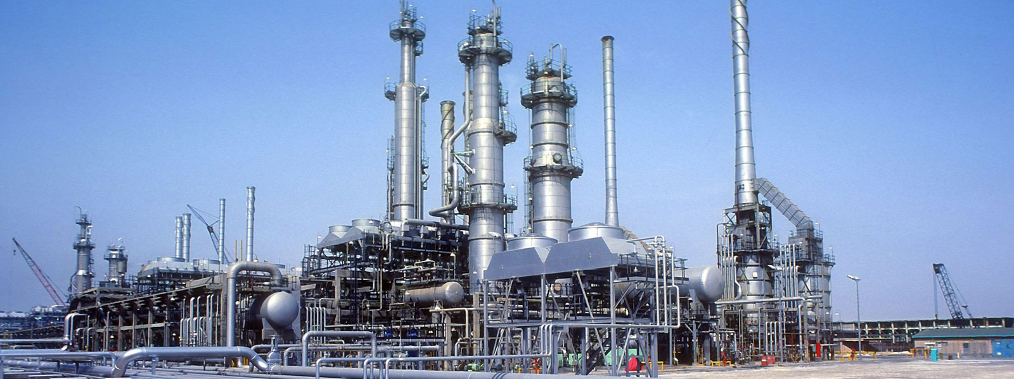

Slide 24
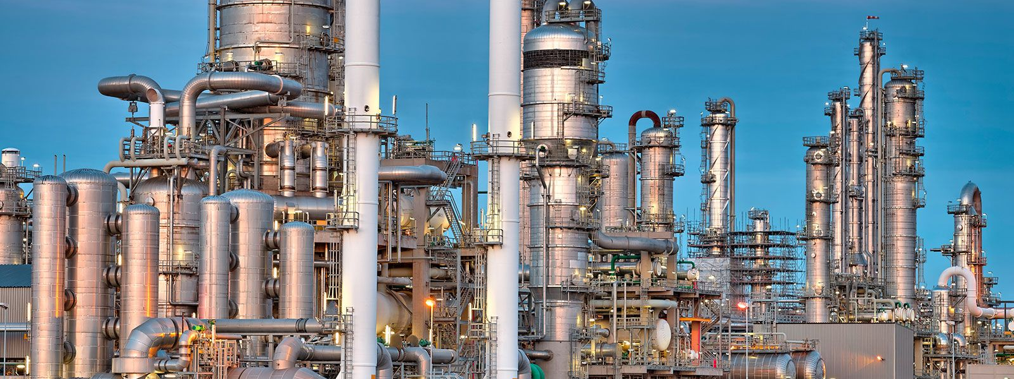

Slide 25
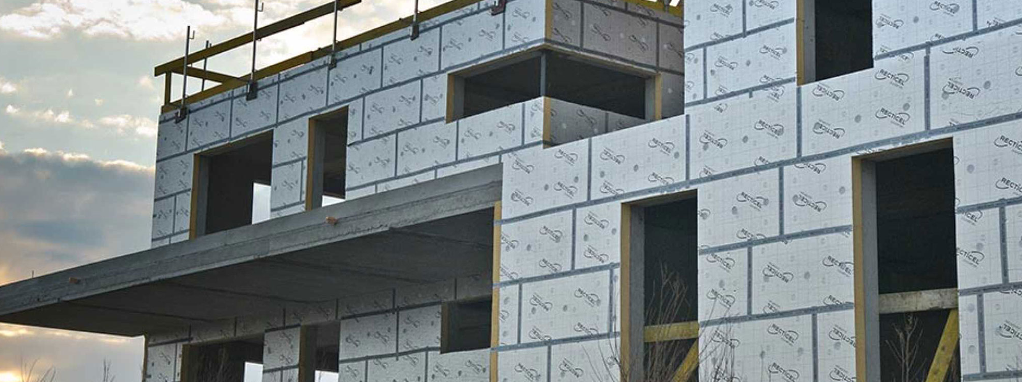

Slide 28
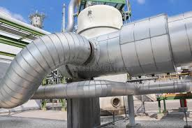

Slide 29
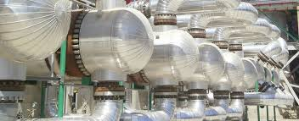

Slide 30
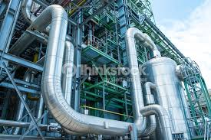

Slide 31
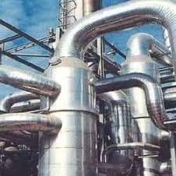

Slide 32
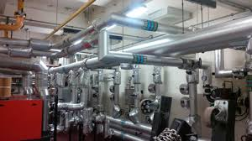

Slide 33
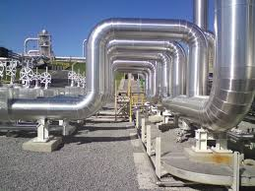

Slide 34
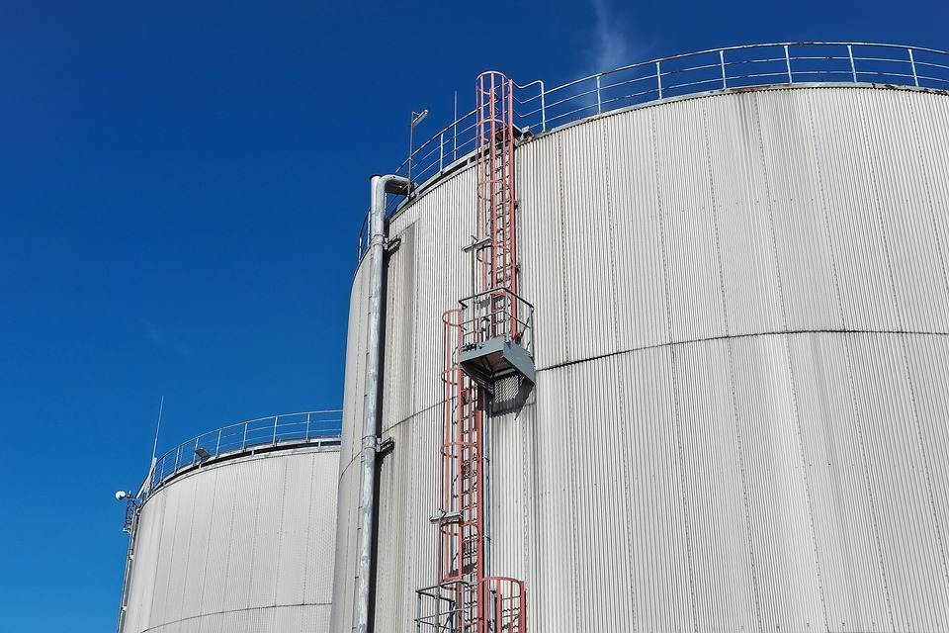

Slide 35
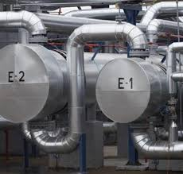

Slide 36
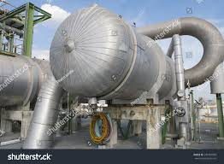

Slide 37
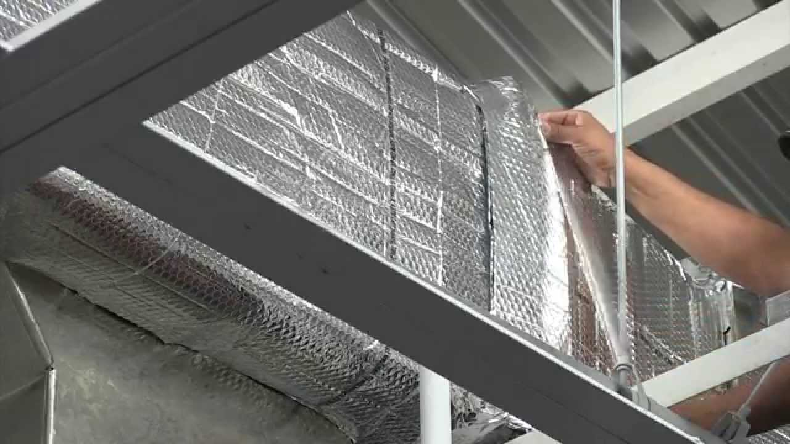

Slide 38
